Slide 1


MetaLexer: A Modular Lexical
Specification Language
Andrew Casey
Laurie Hendren
McGill University
www.sable.mcgill.ca/metalexer
TexPoint fonts used in EMF.
Read the TexPoint manual before you delete this box.: AAAAAAAAAAAAAAAAAAAAA
Notes:
This talk is about MetaLexer, a modular lexical specification language. This work was done by Andrew Casey as his MSc thesis at McGill.

Slide 2
Why MetaLexer?
Why is it relevant to AOSD?
What are the challenges?
Notes:
In this talk I want to motivate why we need MetaLexer, and what are the challenges in designing and implementing MetaLexer.
Why is it relevant to AOSD? It is a new form of modularization.

Slide 3
Structure of a Compiler Front-End
Scanner (Lexical Analysis)
Parser and Semantic Checks
Regular Expressions +
State (flex, jflex, ...)
Context-free grammars + actions/attributes (yacc, bison, Polyglot, JastAdd, ...)
Notes:
Structure of a traditional compiler front-end.
Scanner hands off tokens to the parser. We will concentration on parsers built with LALR tools ...

Slide 4
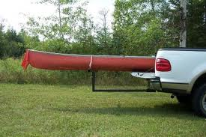
Given a front-end specification for a language (i.e. Java), current method to implement a front-end for an extension of that language (i.e. AspectJ)?
Lexical specification for original language
Grammar and actions for original language
Modified lexical specification for extended language
Grammar and actions for original language
Grammar rules for extension
Notes:
Tools like Polyglot and JastAdd allow for modular extensions of the grammar. However, there is no equivalent extensible way of specifying the extended scanner modularly. We hit this problem when we were building abc, which is an extensible compiler toolkit for AspectJ, and then hit this problem again designing the new McLab system, an extensible compiler toolkit for Matlab.

Slide 5
Desired Modular MetaLexer Approach
Lexical rules for extension
Lexical specification for original language
Grammar and actions for original language
Lexical specification for original language
Grammar and actions for original language
Grammar rules for extension
Notes:
So, we decided to build a tool that would provide a more modular approach.

Slide 6
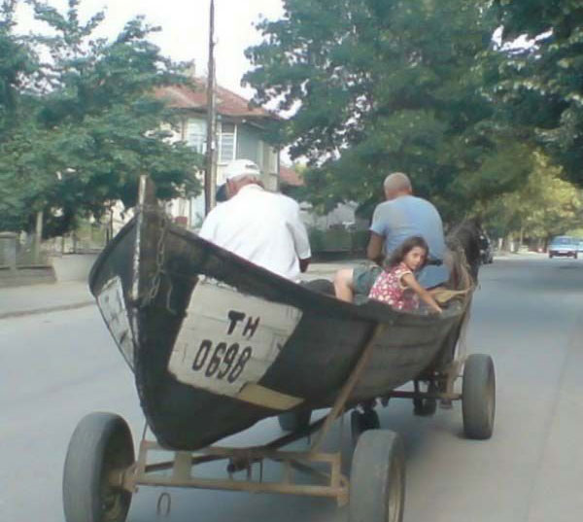
We also want to be able to combine lexical specifications for diverse languages.
Java + HTML
Java + Aspects (AspectJ)
Java + SQL
MATLAB + Aspects (AspectMatlab)

Slide 7
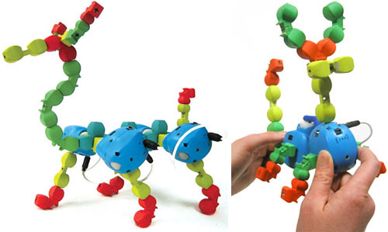
Would like to be able to reuse and extend lexical specification modules
Nested C-style comments
Javadoc comments
Floating-point constants
URL
regular expressions
…

Slide 8

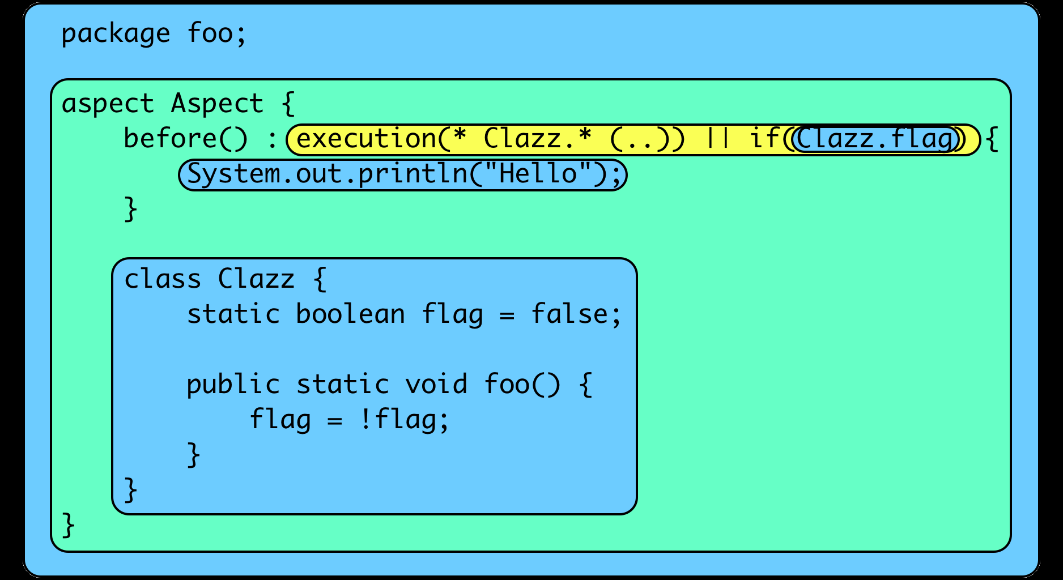
Scanning AspectJ
Notes:
Let’s look at the scanning problem for AspectJ. Different regions of the program have different lexical structures. The outermost region has the lexical structure of Java, but once you enter an Aspect declaration the lexical structure changes. For example, new keywords are introduced, such as “before”. Inside pointcuts, there is even a more radically different lexical structure, which many new symbols inside patterns. Furthermore inside a pointcut specification you can have an “if” pointcut, which contains Java code. So between the opening paren and the matching closing paren the scanner must tokenize as Java.
Furthermore, inside an aspect declaration you may have an inner class, the inner class should be scanned as Java .
Note that each context can be signaled by some sequence of opening tokens and closing tokens. Sometimes the opening and closing tokens must be nested at the same level.

Slide 9
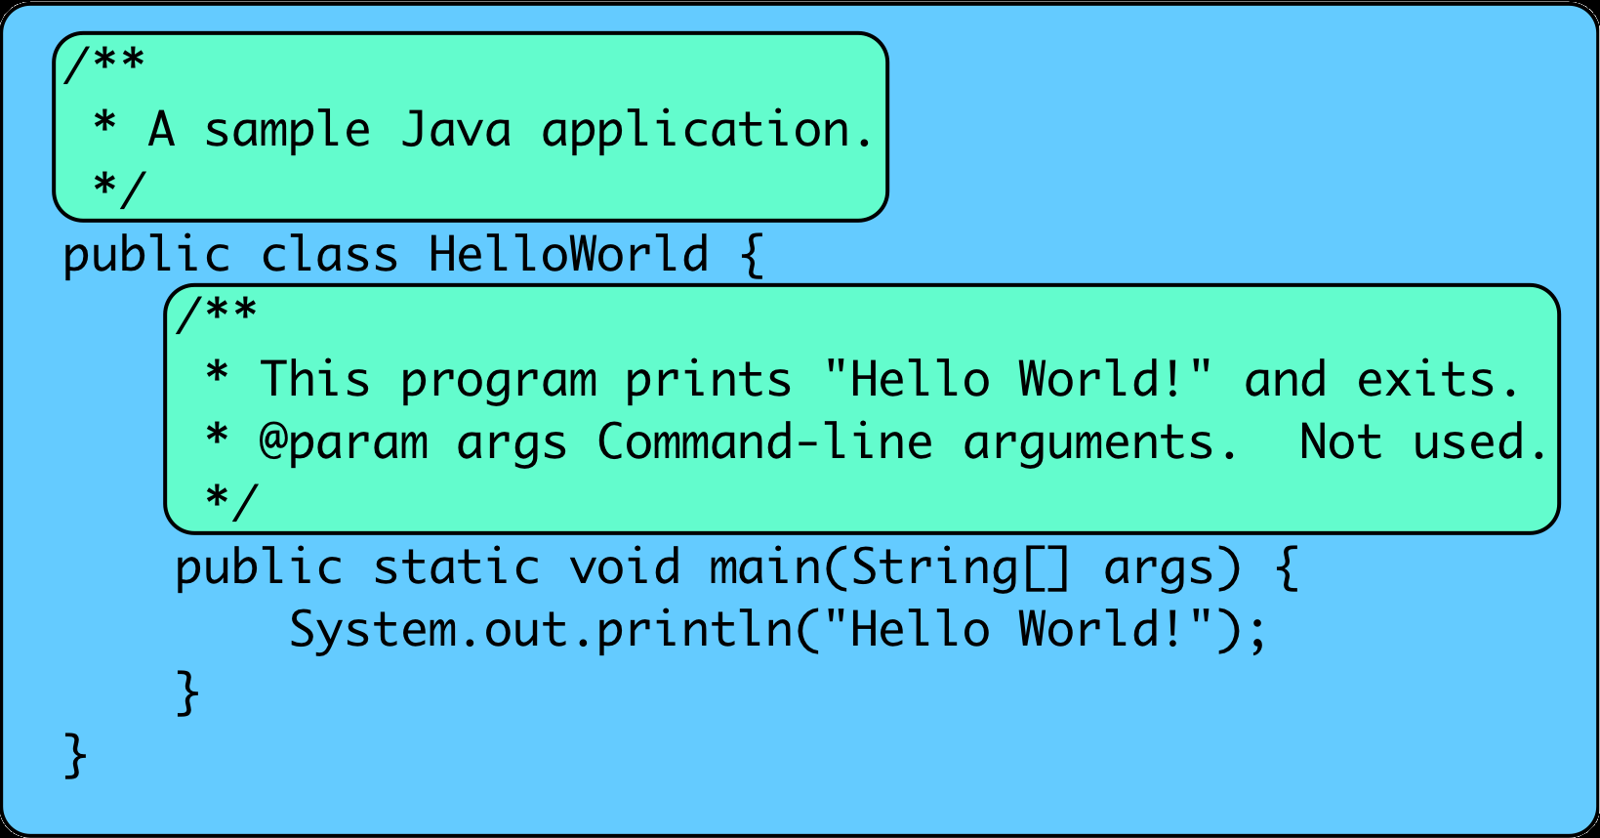
Scanning Java/Javadoc
Notes:
Here is another example of different scanning contexts.

Slide 10

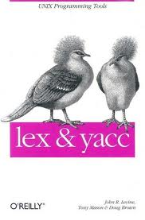
First, let’s understand the traditional lexer tools (lex, flex, jflex).
programmer specifies regular expressions + actions
tools generate a finite automaton-based implementation
states are used to handle different language contexts

Slide 11
Notes:
Here is an example extracted from the Jflex manual for scanning a typical language which includes strings.

Slide 12
Current (ugly) method for extending jflex specifications - copy&modify
Copy jflex specification.
Insert new scanner rules into copy.
  Order of rules matters!
Introduce new states and action logic for converting between states.
Principled way of weaving new rules into existing rules.
Modular and abstract notion of state and changing between states.

Slide 13
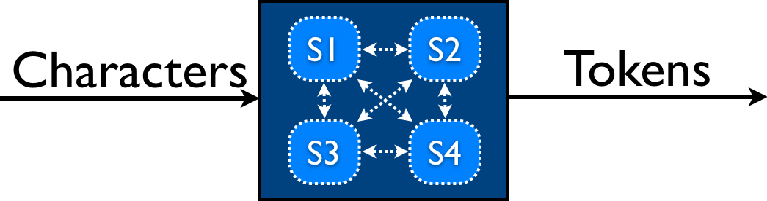
Jflex Lexing Structure
Specification in one file.
Lexing rules associated with a state.
Changing states associated with action code.

Slide 14
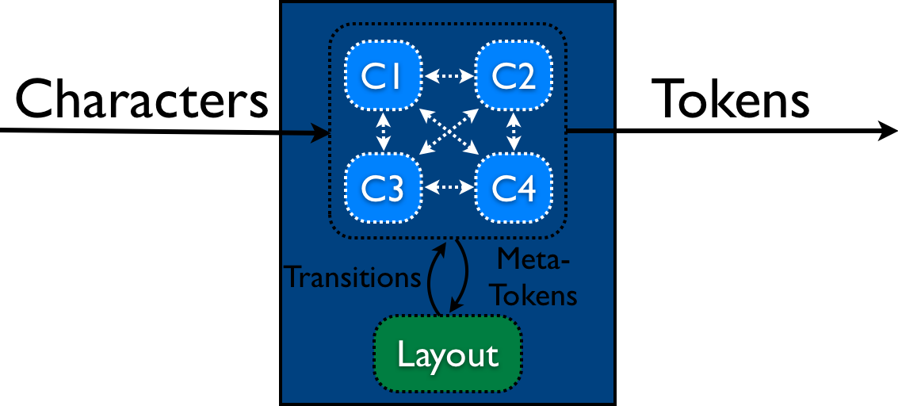
Each component specified in its own file.
MetaLexer Structure
Layout specified in its own file.
Components define lexing rules associated with a state and produce meta-tokens.
Layout defines transitions between components, state changes by meta-lexer.

Slide 15
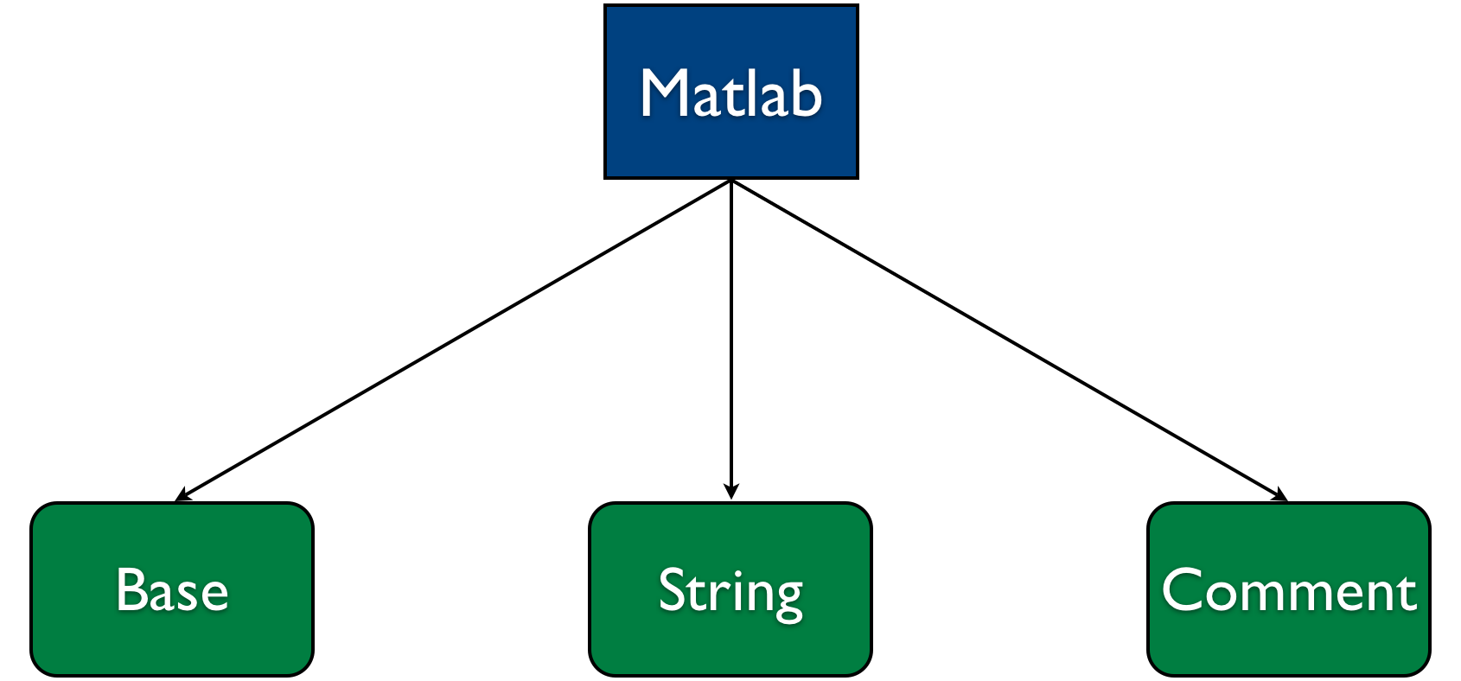
Structure of a MetaLexer Specification for Matlab

Slide 16
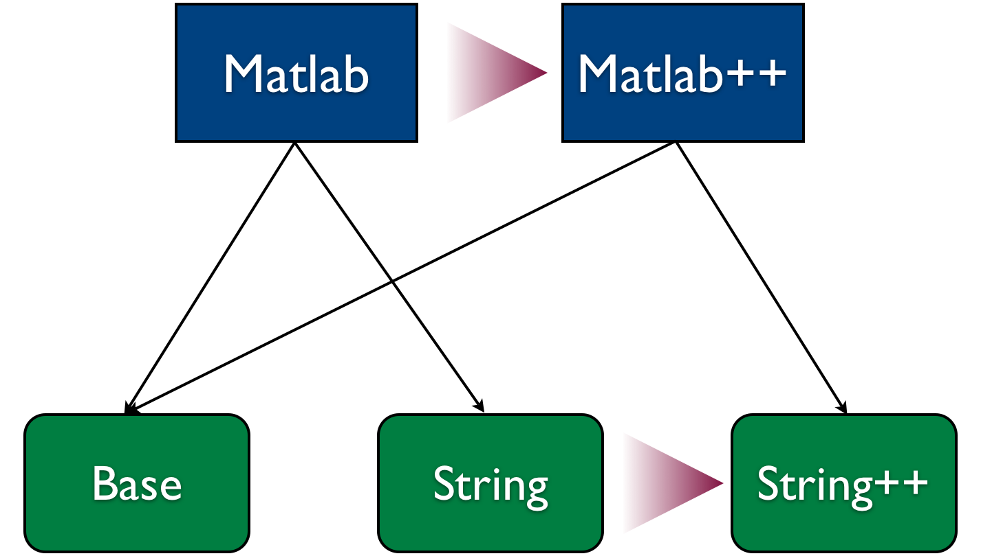
Extending a MetaLexer Specification for Matlab

Slide 17
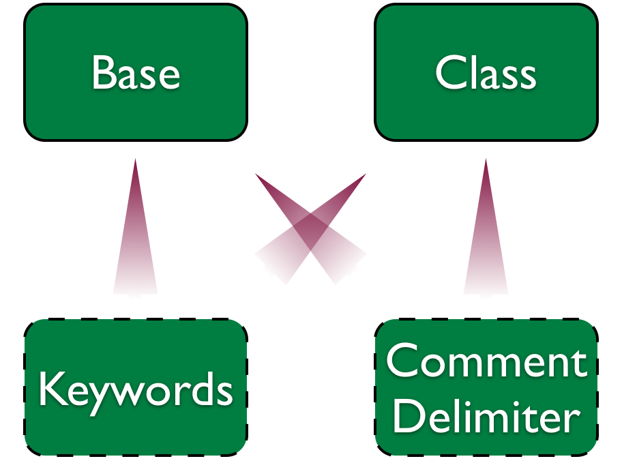
Sharing component specifications with MetaLexer

Slide 18
Scanning a properties file
Properties
Key
Value
Util_Patterns

Slide 19
util_properties.mlc helper component

Slide 20
key.mlc component
Notes:
Three sections of rules: acyclic, cyclic and cleanup.
Note METATOKEN ASSIGN

Slide 21
value.mlc component
Notes:
Note that the value component allows one to build a complete token.
Note the METATOKEN, LINE_TERMINATOR

Slide 22
properties.mll layout
Notes:
Note that this layout includes two components, key and value, and the start component is “key”
The embedding defines the metalexer transitions.
Need to give each transition a name, so we can have a way of modifying or deleting them.

Slide 23
MetaLexer is implemented and available:
www.sable.mcgill.ca/metalexer
properties.mll
util_patterns.mlc
properties.jflex
MetaLexer
key.mlc
value.mlc
Notes:
Explain metalexer.

Slide 24
Key problems to solve:
How to implement the meta-token lexer?
How to allow for insertion of new components, replacing of components, adding new embeddings (metalexer transitions).
How to insert new patterns into components as specific points.

Slide 25
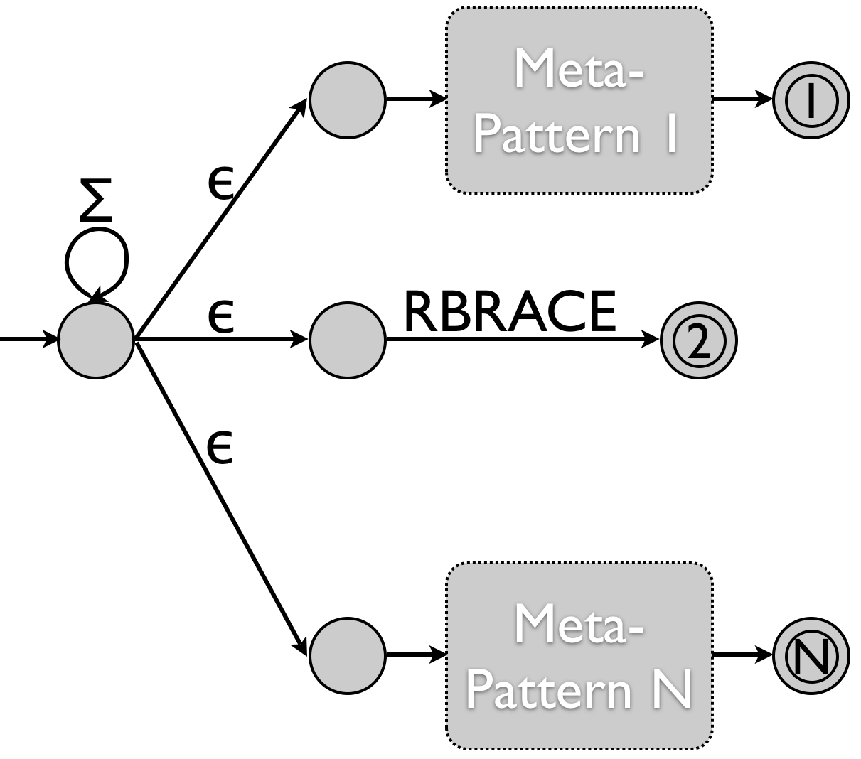
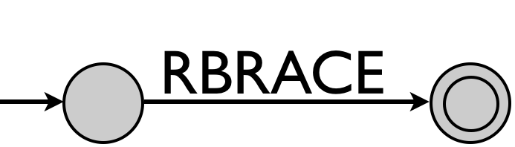
Implementing the meta-token lexer
Recognize a meta-pattern, i.e. when to go to a new component and when to return.
Recognize the matching suffix.
Notes:
Regular pattern lexer communicates with the meta-lexer. When each token of the regular lexer is accepted it receives back a response from the metalexer. If a component should be entered or exited, the matching meta-tokens are provided.
Shortest match.

Slide 26
Implementing inheritance (structured weaving).
Notes:
Reminder of how a lexer extension would look like. Extend or add new components, extend the layout, possibly replacing previous components with newly extended ones.

Slide 27
Implementing MetaLexer layout inheritance
Layouts can inherit other layouts
%inherit directive put at the location at which the inherited transition rules (embeddings) should be placed.
each %inherit directive can be followed by:
  %unoption
  %replace
  %unembed
  new embeddings

Slide 28
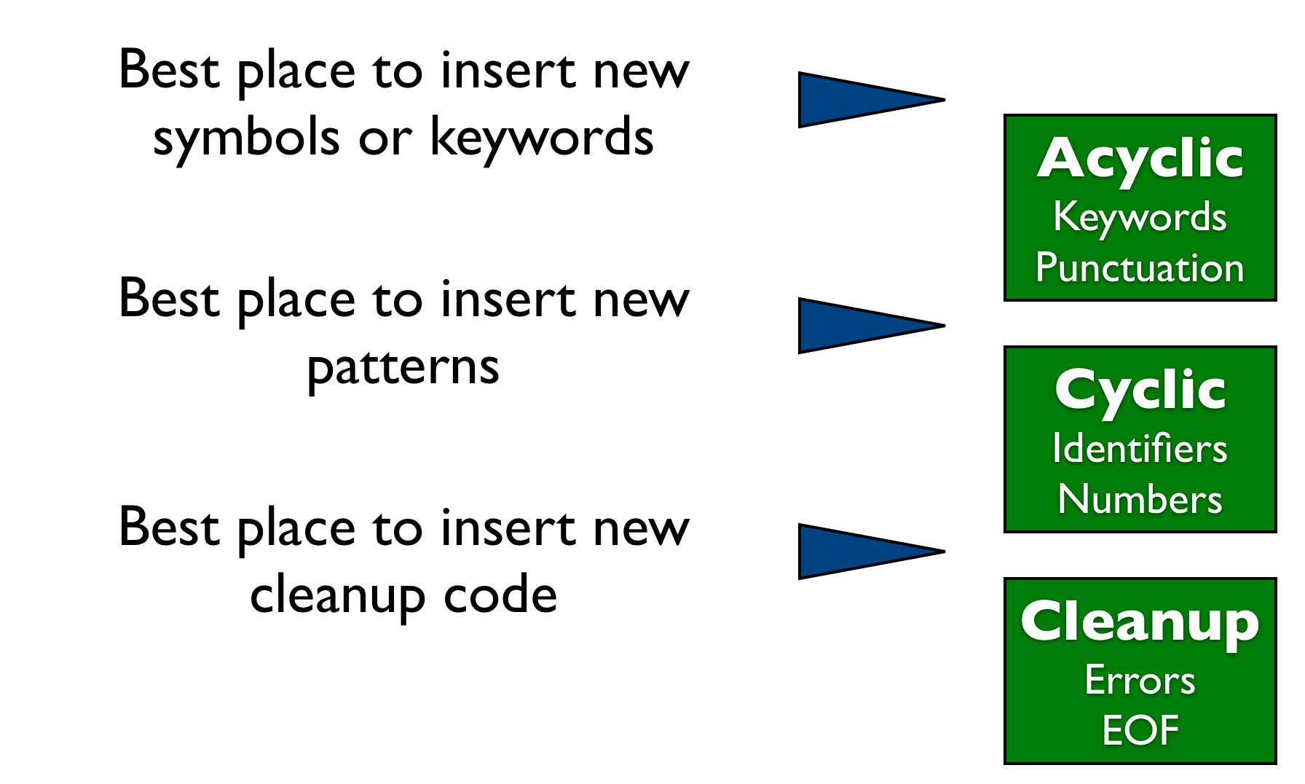
Implementing MetaLexer component inheritance
Notes:
Remember that we need to be able to add new lexing rules at specific places … but don’t want to have to identify every line.

Slide 29
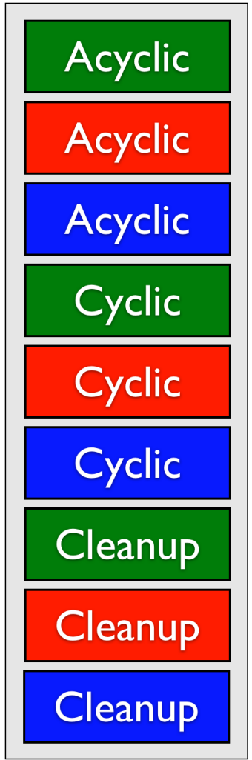
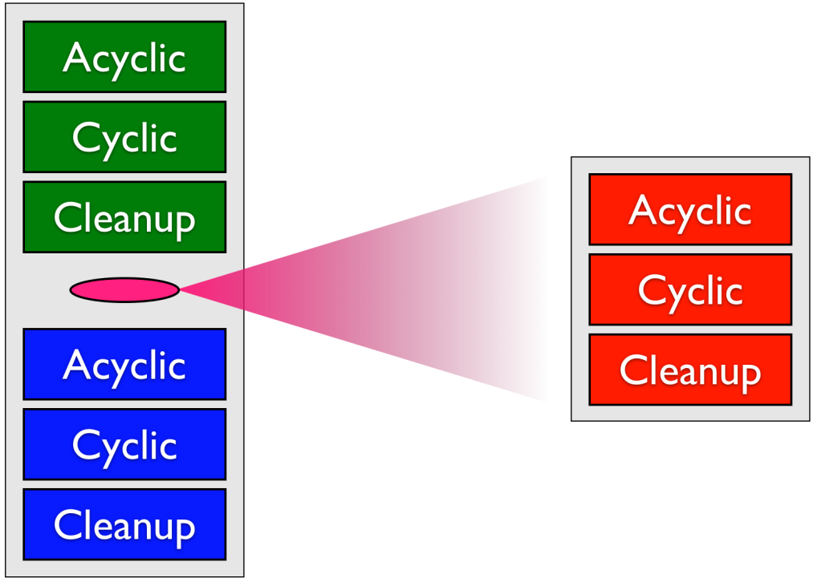
Weaving in inherited component
O
Woven output
New Component adds some rules and inherits original component.
Original Component

Slide 30

Results:
Applied to three projects with complex scanners:
AspectJ (abc and extensions)
Matlab (Annotations and AspectMatlab extensions)
MetaLexer

Slide 31
AspectJ and Extensions

Slide 32
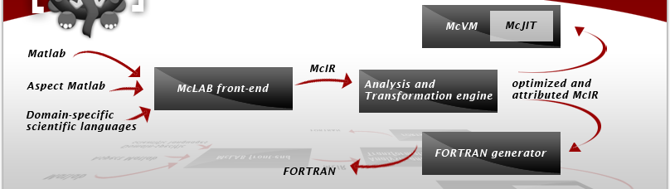
Using MetaLexer for an extensible front end for McLab
PLDI 2011 Tutorial on McLab!!!!!
Notes:
Matlab, AspectMatlab and Annotations.

Slide 33
MetaLexer scanner implemented in MetaLexer
1st version of MetaLexer written in JFlex, one for components and one for layouts.
2nd version implemented in MetaLexer, many shared components between the component lexer and the layout lexer.

Slide 34
Related Work
Ad-hoc systems with separate scanner/ LALR parser
  Polyglot
  JastAdd
  abc
Recursive-descent scanner/parser
  ANTLR and systems using ANTLR
Scannerless systems
  Rats! (PEGs)
Integrated systems
  Copper (modified LALR parser which communicates with DFA-based scanner)
Notes:
Why use LALR .... Grammars available, gives fast parsers ...

Slide 35
Conclusions
MetaLexer allows one to specify modular and extensible scanners suitable for any system that works with JFlex.
Two main ideas: meta-lexing and component/layout inheritance.
Used in large projects such as abc, McLab and MetaLexer itself.
Available at: www.sable.mcgill.ca/metalexer

