Slide 1

Typing Aspects for MATLAB
Laurie Hendren
McGill University
Leverhulme Visiting Professor Oxford Computing Lab
TexPoint fonts used in EMF.
Read the TexPoint manual before you delete this box.: AAAAAAAAAAAAAAAAAAAAA

Slide 2
Why MATLAB?
Why is it important?
Why are types important?
Adding type checks MATLAB style!

Slide 3
Nature Article, “… Why Scientific Computing does not compute”
45% say scientists spend more time programming than 5 years ago.
38% of scientists spend at least 1/5th of their time programming.
Codes often buggy, sometimes leading to papers being retracted. Self-taught programmers.
Monster codes, poorly documented, poorly tested, and often used inappropriately.
Notes:
October 2010 article in Nature, by Zeeya Merali. Survey of 2000 scientists.

Slide 4


FORTRAN
C/C++
MATLAB
PERL
Python
Domain-specific
Java
AspectJ
Notes:
Scientist in upper right ... Many different applications to program, which language to pick. Increasingly picking dynamic or scripting languages. Many scientific and engineering computations use MATLAB.
Computer Scientist, Compiler writer, lower left. Has worked on compilers and tools for object-oriented and aspect-oriented languages ... But scientists are not interested in these languages.

Slide 5
A lot of MATLAB programmers!
started as an interface to standard FORTRAN libraries for use by students.... but now
1 million MATLAB programmers in 2004, number doubling every 1.5 to 2 years.
over 1200 MATLAB/Simulink books
used in many sciences and engineering disciplines

Slide 6
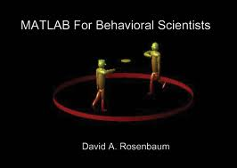

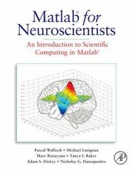
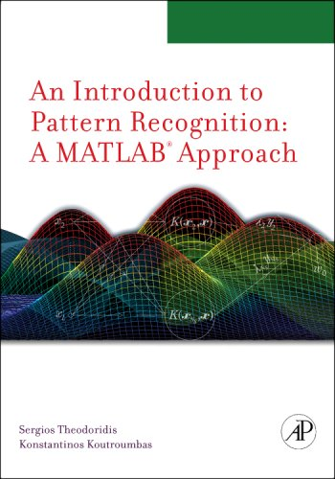
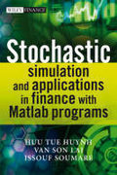

Notes:
Number and variety of disciplines ….

Slide 7
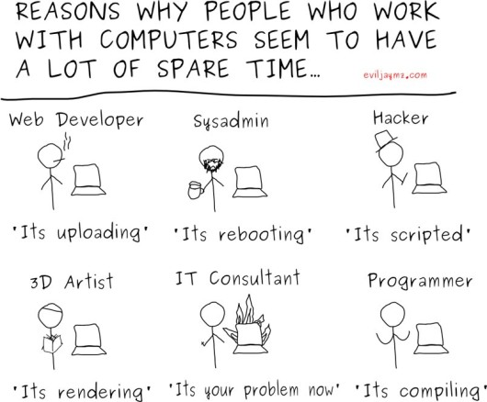
MATLAB
FORTRAN
Why do scientists choose MATLAB?
Notes:
Why do scientists choose MATLAB?
Why not something like FORTRAN? - advantages are good compilers, efficient execution.
But programmers are choosing MATAB – faster prototyping – no types, lots of toolboxes, interactive development style...

Slide 8
Implications of choosing a dynamic, “scripting” language like MATLAB, which has dynamic types….

Slide 9

Interpreted …
Potentially large
runtime overhead in
both time and
space

Slide 10
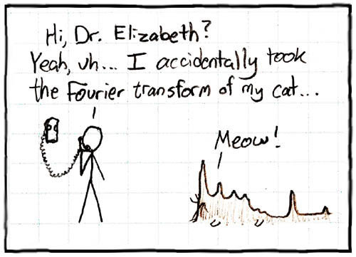
No Types and “Flexible” Syntax ....

Slide 11
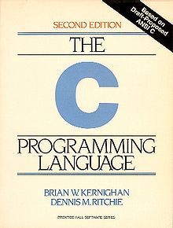

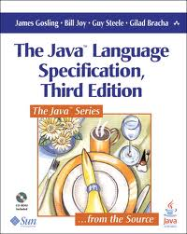
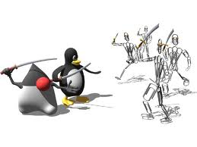
Lack of a formal standard and open source compilers for MATLAB
Notes:
Lack of research – the semantics can change in a new release from Mathworks
Part of defining typing aspects is to give a clear definition of Matlab types.

Slide 12
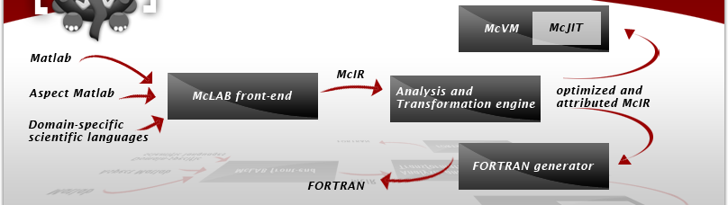
McLAB – an infrastructure for compilers and VMs for MATLAB
What if we extend the language to include typing aspects?
Notes:
Talk about front-end and back-ends. Focus on why types are important, for both program reliability and efficiency.

Slide 13
Simple Example MATLAB function

Slide 16
MATLAB programmers often expect certain types.

Slide 18
High-level types in MATLAB
Notes:
Array, homogeneous rectangular array with n dimensions and a basetype.
Cellarray, rectangular array with n dimensions, each element is a cell which can contain any type.
Struct, a heterogeneous structure with fieldnames associated with values.
Focus mostly on arrays. Let’s look at the basetype of arrays.

Slide 19
Notes:
Leaves on the right are all of the concrete basetypes. For example int32, uint64.
By defaults types are double, but other basetypes can be created explicitly. Note all the basetypes have a real version and a complex version.

Slide 20
Atype Syntax

Slide 21
Array Syntax

Slide 22
Simple Example
Notes:
Let’s look at the basetypes … int, complex, uint32

Slide 24
Capturing reflective information
a.type
a.value
a.dims
a.basetype

Slide 25
Capturing dimensions and basetype
<n> can be used as a dimension spec
value of n is instantiated from the runtime dimension
repeated use in same atype statement implies equality

Slide 27
Example with a cellarray of structs

Slide 28
Semantics: atype(‘name’, ‘type’)
Find matching variables, raise error if none exist. A conservative existance check could be done statically by the compiler.
Check run-time type against static specification, raise error if mismatch.
Bind context and specification free variables. Only bind those which are live after this statement.
Notes:
Check run-time, can use MATLAB built-ins.

Slide 29
Implementation
Can be implemented at different levels:
  Raise error if type mismatch
  Log warnings for type mismatches
  Insert MATLAB comments
Implementation can be via:
  MATLAB library
  Matcher/Weaver (add to AspectMatlab)

Slide 30
Are “Typing Aspects” AOP?
Aspect Ideas
MATLAB-style
programming
atype statements not in a separate module (could be, but not very useful as documentation)
has matching/weaving
observes and captures run-time context

Slide 31
How will we use typing aspects?
annotate library MATLAB code, determine if the specification is rich enough
develop static type analyses which can use the information conveyed by the atype statements (useful for MATLAB to FORTRAN compiler)

Slide 32
Related Work
Static type analysis (ahead-of-time and JIT compilers). (MaJIC and FALCON -Padua’s group, McJIT and McFOR– my group)
Types for other dynamic scripting languages. (Ruby – Furr, An, Foster & Hicks; Pluggable Types – Papi, Ali, Correa, Perkins & Ernst)

Slide 33
Ongoing work
Complete implementation of typing aspects, both as a library and via a weaver – hopefully summer 2011. (… convince my students they are a good idea …)
Release of three main tools: front-end/analysis framework, McVM (Virtual Machine) and McFor (MATLAB to FORTRAN). PLDI 2011 tutorial.
Refactoring tools for MATLAB. How to help programmers convert their programs to better structured, and more efficient codes?

Slide 34
Conclusions
MATLAB is an important language.
Many challenges, types a key challenge.
Types are dynamic, but important for program understanding and performance.
Typing aspects one approach.
www.sable.mcgill.ca/mclab

